Slide 1


Ensemble Techniques– Day 2
AIML
POST GRADUATE PROGRAM
ARTIFICIAL INTELLIGENCE & MACHINE LEARNING

Slide 2
Learning Objectives
Understand modeling errors
Bias error
Variance error
To learn the Ensemble Techniques and their impact on modelling errors
Ada Boosting
Gradient Boosting
Stacking
The advantage and disadvantages of the technique ensemble technique

Slide 3
Bias-Variance error
We can decompose the error of the learned model into two parts:
  Bias Error : It is the difference between predicted values and actual values of the model
    This class of models can’t fit the training data.
    Accuracy is low both in training and testing data
    Fix: a more complex model class.
  Variance Error : It is the variation in the prediction when a data from different distribution is used
    This class of models could fit the training data well but fail to fit in test because of different distribution of data
    Accuracy in test is relatively much lower than in training
    Fix: a less complex model class.

Slide 4
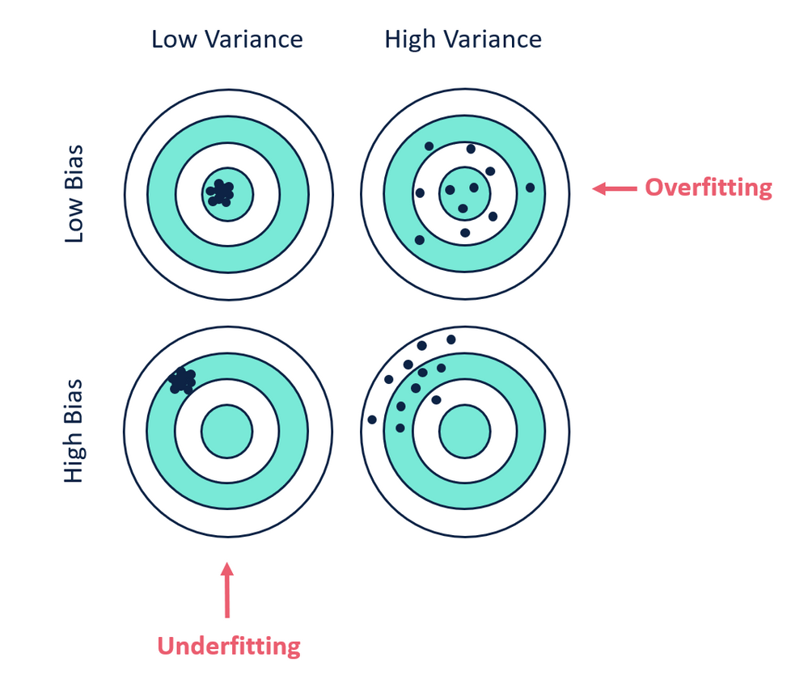
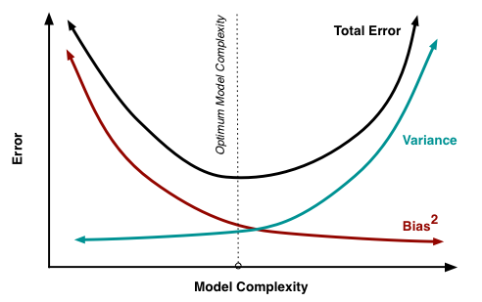
Bias and variance using bulls-eye diagram
Image Source: https://community.alteryx.com/t5/Data-Science/Bias-Versus-Variance/ba-p/351862

Slide 5
Boosting Concept
Boosting is a general ensemble method that creates a strong classifier from a number of weak classifiers.
Similar to bagging, but the learners are grown sequentially; except for the first, each subsequent learner is grown from previously grown learners.
Employ multiple weak learners, which is only a slight improvement over random guessing.
Committee based decision makes it powerful, since individual classifiers often are too primitive.
However, with sufficient number of instances, such an approach helps us reduce general bias using many high-bias models.
Two prominent boosting algorithms are AdaBoost, short for Adaptive Boosting and Gradient Boost short for Gradient Descent Boosting

Slide 6
Ensemble Methods (AdaBoosting)
In AdaBoost, the successive models are created with a focus on the ill fitted data of the previous learner. Each successive model focuses more and more on the harder to fit data i.e. their residuals in the previous model
Model instances are created sequentially; except for the first, each subsequent model is grown from previously grown learners
During voting higher weight is given to the votes of models which perform better in respective training data unlike Bagging where all get equal weight
The trees used in AdaBoost are shallow; they are called “decision stumps” and frequently only have 2 leaves.
Using trees as base learners is not required by the AdaBoost algorithm, but it’s the most common practice.
Boosting slows down learning (because it is sequential) but the model generally performs well.

Slide 7
Ensemble Methods (AdaBoosting) - Continued
When creating an AdaBoost model, all training samples have weights assigned to them. Initially, all weights are the same and equal 1/N, where N is the number of samples
After training one tree, the weights of wrongly classified samples are increased. A dataset with updated weights then serves as an input to another tree from the ensemble
This procedure is repeated as long as adding a new tree results in reducing training error or until the maximum number of trees is reached.
Output prediction is the weighted average of predictions from shallow trees
classifier weights reflect their training accuracies. The larger the weights are the more accurate the instance is

Slide 8
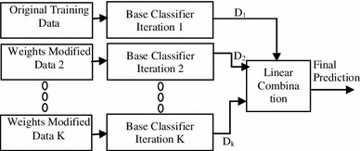


AdaBoost
Training data from base data with focus on instances which were incorrectly classified by earlier model (if any)
Voting could be simple
or weighted
K similar classifiers created in sequence with respective training data with focus on addressing the misclassified data, not the usual cost functions
It is called Adaptive Boosting as the weights are re-assigned to each instance, with higher weights to incorrectly classified instance
Source: https://link.springer.com/article/10.1007/s13721-013-0034-x

Slide 9
Ensemble Methods(Gradient Boosting)
Similarly to AdaBoost, gradient tree boosting is built from a set of small trees, though usually slightly deeper than decision stumps.
The trees are trained sequentially, just like in AdaBoost, but the training of individual trees is not the same
Each model is fit on a modified version of original data (original data is replaced with the x values and residuals from previous model
By fitting new models to the residuals, the overall model gradually improves in areas where residuals are initially high
The main idea behind the algorithm is to iteratively find new trees that minimize loss function—a measure of telling how bad the model is.

Slide 10
Ensemble Methods (Gradient Boosting)- continued
This function has to be differentiable (smooth, continuous, within limits), and it’s selected based on the problem that needs solving
For classification problems, we usually use the log loss function, which is simply the negative mean of log-probabilities where sample xi is classified as its label yi:
Knowing the loss value, we can calculate the so-called “pseudo-residuals.” The greater the residual, the bigger the mistake. Pseudo-residuals are then used instead of labels when training a new tree.

Slide 11
Ensemble Methods (Gradient Boosting)- continued
By fitting new models to the residuals, the overall model gradually improves in areas where residuals are initially high
The main idea behind the algorithm is to iteratively find new trees that minimize loss function—a measure of telling how bad the model is.
This function has to be differentiable, and it’s selected based on the problem that needs solving
Gradient tree boosting is similar to AdaBoost, but instead of looking only at where it has failed, it also draws your attention to how much it has failed.

Slide 12

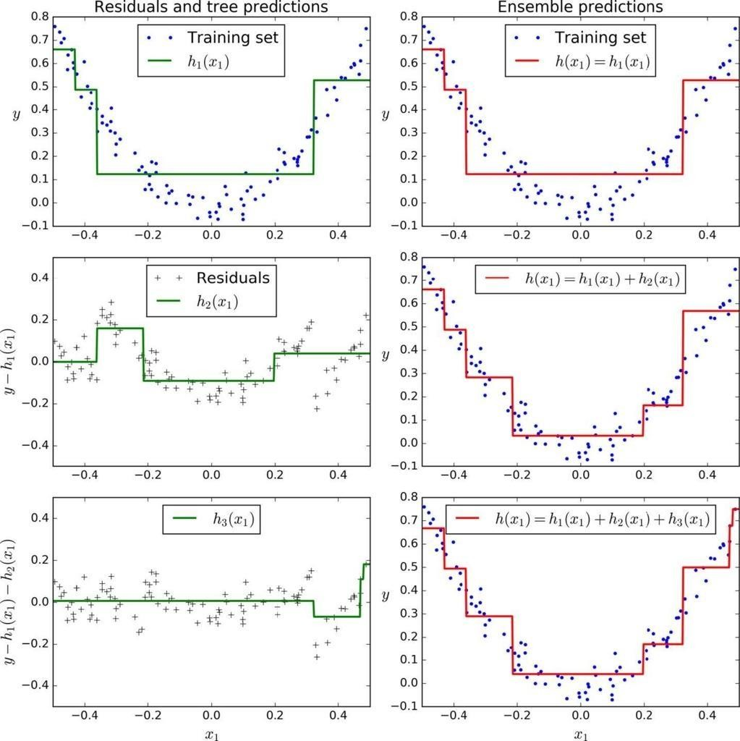




Gradient Boost
First learner results in residuals (dots that fall above and below the surface. The result (red) is same as first classifier
Next classifier focuses on the residuals of the first classifier to reclassify them as correctly as possible
The combined effect of this surface and previous classifier surface is shown in red
The third learner focusses on the residuals of the previous classifier
The combine result of the new surface with the previous surface is shown in red

Slide 13
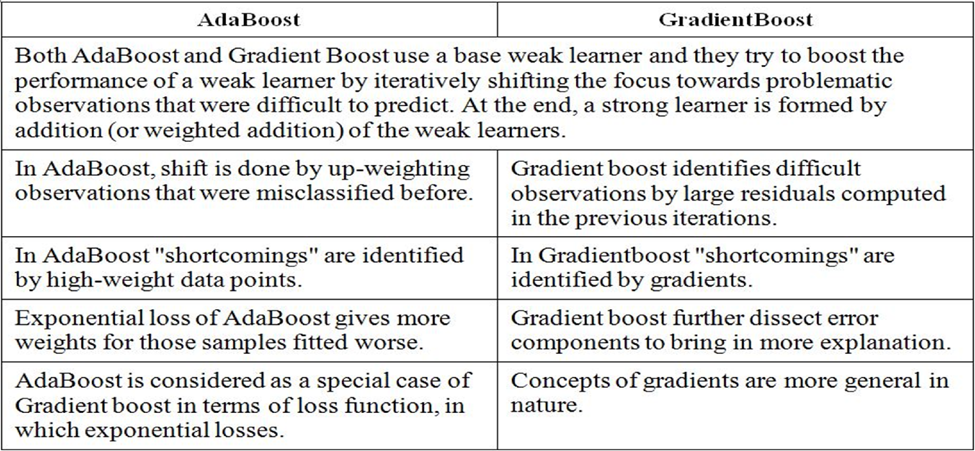
Difference between Adaboost and GradientBoost

Slide 14
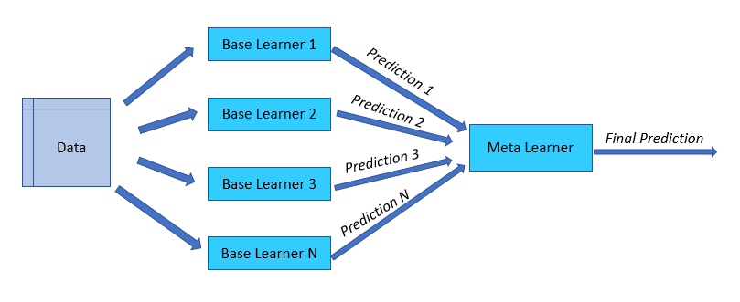
Ensemble Method -Stacking

Slide 15
Stacking
Similar to bagging, but apply several different models to original data
The weights for each model are determined based on how well they perform on the given input data
Similar classifiers usually make similar errors (bagging), so forming an ensemble with similar classifiers may not improve the classification rate
Presence of a poorly performing classifier may cause performance deterioration in the overall performance

Slide 16
Stacking - continued
Similarly, even on presence of a classifier that performs much better than all of the other available base classifiers, may cause degradation in the overall performance
Another important factor is the amount of correlation among the incorrect classifications made by each classifier
If the consistent classifiers tend to misclassify the same instances, then combining their results will have no benefit
In contrast, a greater amount of independence among the classifiers can result in errors by individual classifiers being overlooked when the results of the ensemble are combined.

Slide 17
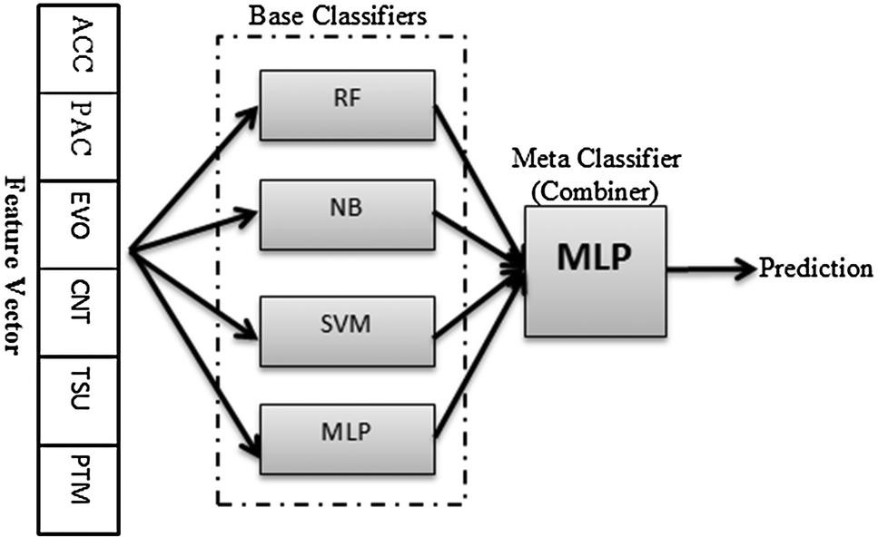
Stacking - Visualization

Slide 18
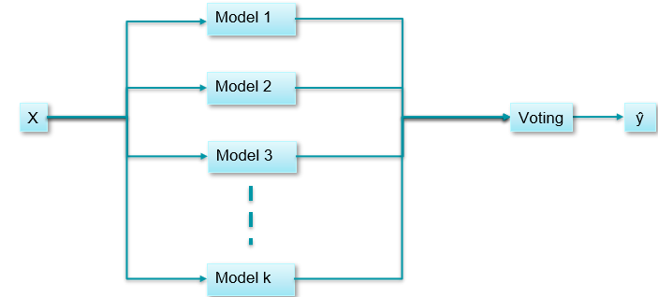
Stacking – Voting classifier

Slide 19
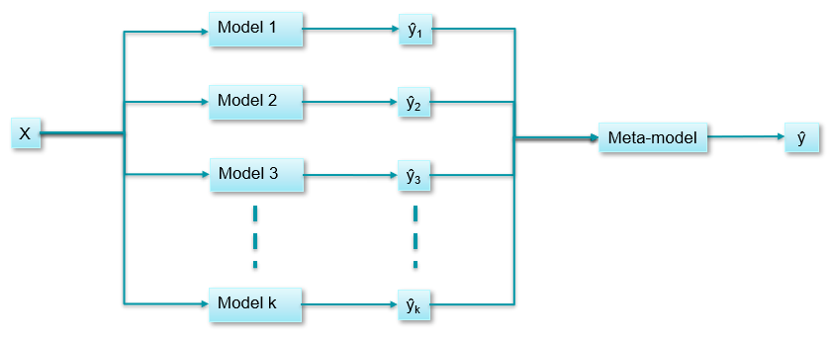
Stacking – Meta model

Slide 20
Advantages / Disadvantages of Ensemble Technique

Slide 21
Ensemble methods have higher predictive accuracy, compared to the individual models.
Ensemble methods can reduce bias/variance in the models, which means it can solve underfitting /overfitting problems.
Ensemble models is always less noisy and is more stable.
Ensemble models are less interpretable as we combine predictions.
Ensemble Techniques are expensive in terms of both time and space.
Ensemble models do not always improve accuracy. In any modelling exercise it is important to start simple and then improvise with advanced modelling techniques.
Disadvantages
Advantages

